Slide 1

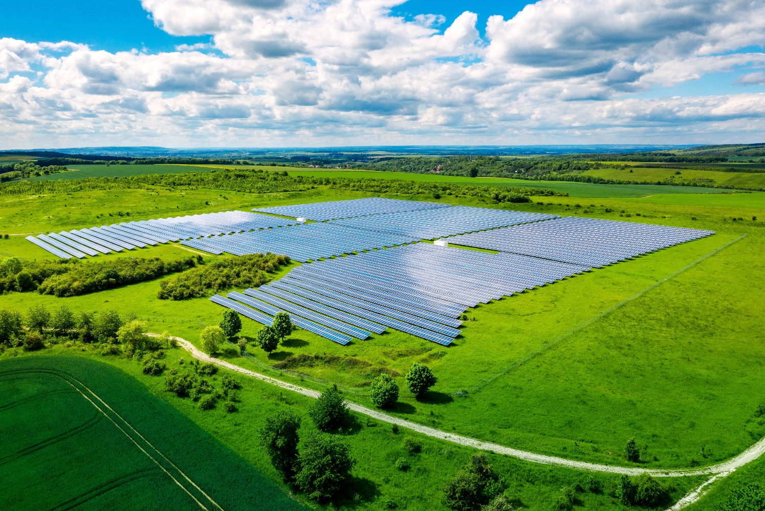
Forecasting Utility-Scale PV Solar Uptake in Aotearoa
Allan Miller
2 December 2020
EEA Asset Management Forum

Slide 2
Forecasting utility-scale PV solar uptake
Objectives
Utility-scale
  1 MW to 200 MW
  Significant power flow requiring a direct connection to the HV transmission or HV/MV distribution network
  Within the capacity of a single HV line
  Solar farms
Acknowledgements
  This work was commissioned by MBIE
  Transpower provided substantial support and data, Powerco provided data
  Data from public sources (LINZ, NIWA, Electricity Authority, Landcare Research)
https://www.mbie.govt.nz/dmsdocument/11639-utility-scale-solar-forecast-in-aotearoa-new-zealand
-Confidential-

Slide 3
Objectives
Contribute to the MBIE Electricity Demand and Generation Scenarios (EDGS)
Investigate the potential capacity and generation from utility-scale solar
  MW versus time and location
  By network connection
Contribute to Transpower and distributor planning
Understand how solar might contribute to meeting more renewable energy generation and ultimately net-zero emissions
Small-scale rooftop and commercial excluded in this study
-Confidential-

Slide 4
Contents
How we went about the study and economics of PV
What the forecast uptake is and where
Key conclusions
(Utility-scale solar technology)
-Confidential-

Slide 5
How we went about the study and economics of PV
-Confidential-

Slide 6
How we went about the study and economics of PV
Absence of built schemes
Proposed method to consider
  Land-use
  Solar resource
  Grid capacity, proximity to transmission and distribution, line build cost
  Economics of solar and acceptable rates of return
Review of other studies world wide:
  Potential PV uptake in California (Nature Climate Change). Specific to USA, only considers solar resource and land type. Did not consider economic and grid capacity
  NREL: land use requirements only
  Greenpeace and other studies in Spain: land use only
  Numerous studies considered the technical integration of PV into electricity grids. E.g. Solar Energy
    Such technical investigations are a necessary part of investigating PV connection; this study only goes as far as considering capacity
  No studies that looked at land-use, solar resource, grid capacity and economics together
-Confidential-

Slide 7
Single model combining:
(1) Land use, (2) grid capacity/cost of extension, (3) solar resource, (4) solar costs, (5) electricity prices
→ solar farm rate of return
-Confidential-

Slide 8
How
All New Zealand North and South Islands by 267,535 km x km cells
(1) Land use & (2) Grid Capacity
Land classes suitable for utility-scale solar by km x km land cells
Included: grassland (high, low, depleted)
Excluded: forests, natives, national parks, crops, vineyards, orchards, urban areas etc
Cost model of land based on land class and proximity to population centres
Single model combining:
(1) Land use, (2) grid capacity/cost of extension, (3) solar resource, (4) solar costs, (5) electricity prices
→ solar farm rate of return
-Confidential-

Slide 9
How
All New Zealand North and South Islands by 267,535 km x km cells
(1) Land use & (2) Grid Capacity
Land classes suitable for utility-scale solar by km x km land cells
Included: grassland (high, low, depleted)
Excluded: forests, natives, national parks, crops, vineyards, orchards, urban areas etc
Cost model of land based on land class and proximity to population centres
Single model combining:
(1) Land use, (2) grid capacity/cost of extension, (3) solar resource, (4) solar costs, (5) electricity prices
→ solar farm rate of return
Proximity of each km x km land cell to suitable electricity transmission grid (GXP) or distribution network (MV lines) infrastructure including cost of connection and maintenance
-Confidential-

Slide 10
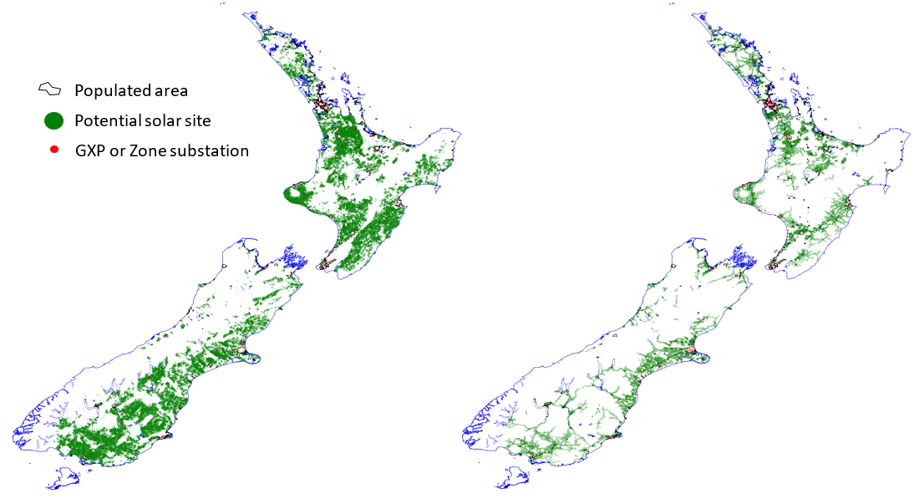
How
All New Zealand North and South Islands by 267,535 km x km cells
(1) Land use & (2) Grid Capacity
Land classes suitable for utility-scale solar by km x km land cells
Included: grassland (high, low, depleted)
Excluded: forests, natives, national parks, crops, vineyards, orchards, urban areas etc
Cost model of land based on land class and proximity to population centres
Single model combining:
(1) Land use, (2) grid capacity/cost of extension, (3) solar resource, (4) solar costs, (5) electricity prices
→ solar farm rate of return
Proximity of each km x km land cell to suitable electricity transmission grid (GXP) or distribution network (MV lines) infrastructure including cost of connection and maintenance
Transmission
(16%)
Distribution
(12%)
-Confidential-

Slide 11
How
All New Zealand North and South Islands by 267,535 km x km cells
(3) Solar resource
Land classes suitable for utility-scale solar by km x km land cells
Solar generating potential (capacity factor) by km x km land cells
Cost model of land based on land class and proximity to population centres
Single model combining:
(1) Land use, (2) grid capacity/cost of extension, (3) solar resource, (4) solar costs, (5) electricity prices
→ solar farm rate of return
Proximity of each km x km land cell to suitable electricity transmission grid (GXP) or distribution network (MV lines) infrastructure including cost of connection and maintenance
-Confidential-

Slide 12
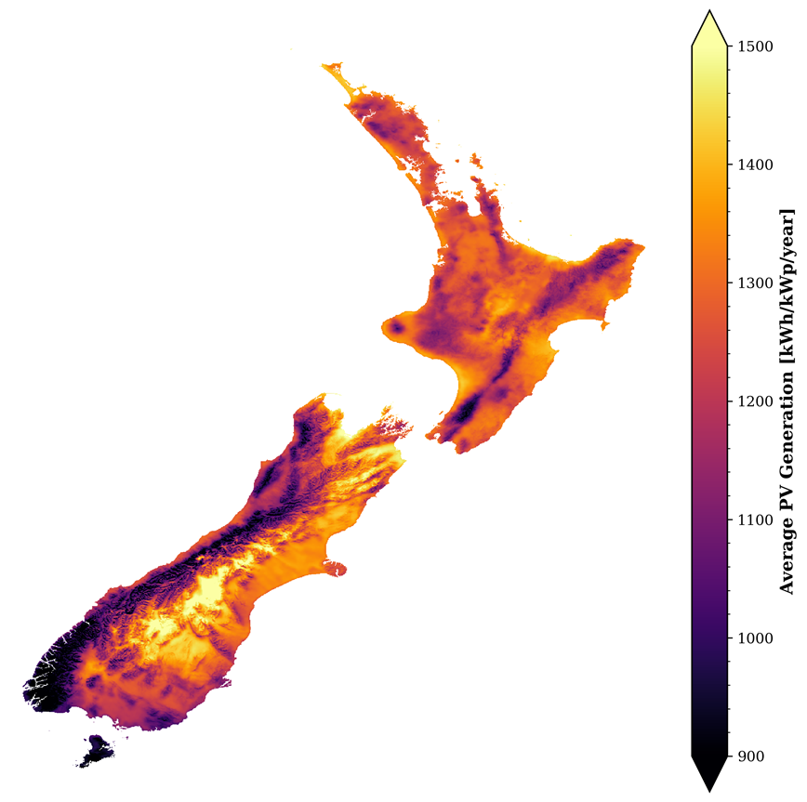
How
All New Zealand North and South Islands by 267,535 km x km cells
(3) Solar resource
Land classes suitable for utility-scale solar by km x km land cells
Solar generating potential (capacity factor) by km x km land cells
cf=0.2
Cost model of land based on land class and proximity to population centres
Single model combining:
(1) Land use, (2) grid capacity/cost of extension, (3) solar resource, (4) solar costs, (5) electricity prices
→ solar farm rate of return
Proximity of each km x km land cell to suitable electricity transmission grid (GXP) or distribution network (MV lines) infrastructure including cost of connection and maintenance
cf=0.12
-Confidential-

Slide 13
How
All New Zealand North and South Islands by 267,535 km x km cells
(4) Solar costs
Land classes suitable for utility-scale solar by km x km land cells
Solar generating potential (capacity factor) by km x km land cells
Cost model of land based on land class and proximity to population centres
Single model combining:
(1) Land use, (2) grid capacity/cost of extension, (3) solar resource, (4) solar costs, (5) electricity prices
→ solar farm rate of return
PV system capital costs
Proximity of each km x km land cell to suitable electricity transmission grid (GXP) or distribution network (MV lines) infrastructure including cost of connection and maintenance
PV system operation and maintenance costs
-Confidential-

Slide 14
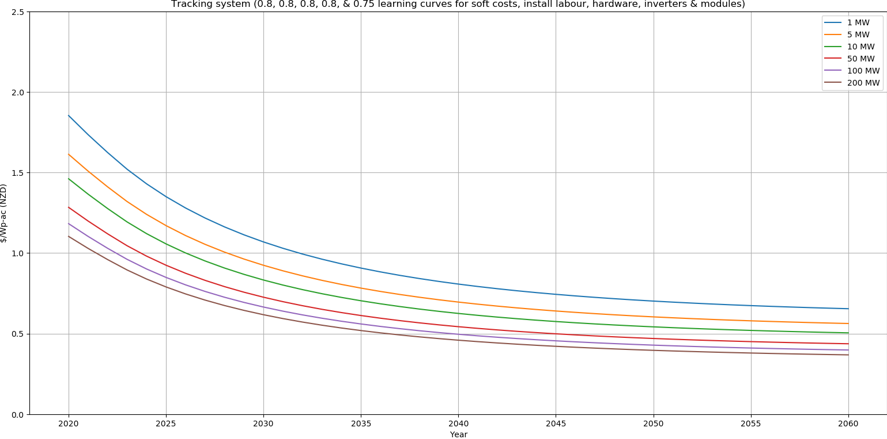
All New Zealand North and South Islands by 267,535 km x km cells
(4) Solar costs
Land classes suitable for utility-scale solar by km x km land cells
Solar generating potential (capacity factor) by km x km land cells
Cost model of land based on land class and proximity to population centres
$1.8 $/Wp
Single model combining:
(1) Land use, (2) grid capacity/cost of extension, (3) solar resource, (4) solar costs, (5) electricity prices
→ solar farm rate of return
$0.7 $/Wp
$1.1 $/Wp
PV system capital costs
$0.4 $/Wp
Proximity of each km x km land cell to suitable electricity transmission grid (GXP) or distribution network (MV lines) infrastructure including cost of connection and maintenance
PV system operation and maintenance costs
-Confidential-

Slide 15
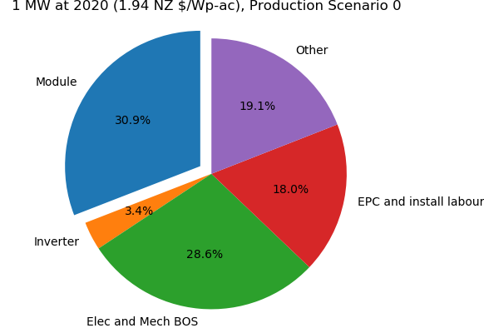
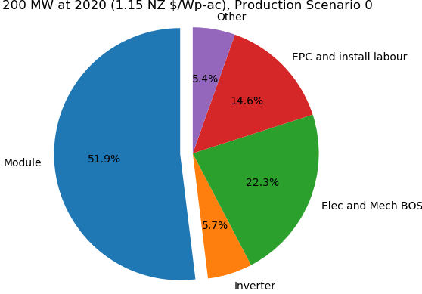
(4) Solar costs
-Confidential-

Slide 16
How
(5) Electricity prices by location
All New Zealand North and South Islands by 267,535 km x km cells
Land classes suitable for utility-scale solar by km x km land cells
Solar generating potential (capacity factor) by km x km land cells
Cost model of land based on land class and proximity to population centres
Electricity prices by location
Single model combining:
(1) Land use, (2) grid capacity/cost of extension, (3) solar resource, (4) solar costs, (5) electricity prices
→ solar farm rate of return
PV system capital costs
Proximity of each km x km land cell to suitable electricity transmission grid (GXP) or distribution network (MV lines) infrastructure including cost of connection and maintenance
PV system operation and maintenance costs
-Confidential-

Slide 17

How
(5) Electricity prices by location
All New Zealand North and South Islands by 267,535 km x km cells
Land classes suitable for utility-scale solar by km x km land cells
Solar generating potential (capacity factor) by km x km land cells
Cost model of land based on land class and proximity to population centres
Electricity prices by location
Single model combining:
(1) Land use, (2) grid capacity/cost of extension, (3) solar resource, (4) solar costs, (5) electricity prices
→ solar farm rate of return
PV system capital costs
Proximity of each km x km land cell to suitable electricity transmission grid (GXP) or distribution network (MV lines) infrastructure including cost of connection and maintenance
PV system operation and maintenance costs
-Confidential-

Slide 18
How
Economic model assumptions
All New Zealand North and South Islands by 267,535 km x km cells
Land classes suitable for utility-scale solar by km x km land cells
Solar generating potential (capacity factor) by km x km land cells
Cost model of land based on land class and proximity to population centres
Electricity prices by location
Economic assumptions
Single model combining:
(1) Land use, (2) grid capacity/cost of extension, (3) solar resource, (4) solar costs, (5) electricity prices
→ solar farm rate of return
PV system capital costs
Proximity of each km x km land cell to suitable electricity transmission grid (GXP) or distribution network (MV lines) infrastructure including cost of connection and maintenance
PV system operation and maintenance costs
-Confidential-

Slide 19
How
Economic model assumptions
All New Zealand North and South Islands by 267,535 km x km cells
Land classes suitable for utility-scale solar by km x km land cells
Solar generating potential (capacity factor) by km x km land cells
Cost model of land based on land class and proximity to population centres
Electricity prices by location
Economic assumptions
Single model combining:
(1) Land use, (2) grid capacity/cost of extension, (3) solar resource, (4) solar costs, (5) electricity prices
→ solar farm rate of return
PV system capital costs
Proximity of each km x km land cell to suitable electricity transmission grid (GXP) or distribution network (MV lines) infrastructure including cost of connection and maintenance
PV system operation and maintenance costs
-Confidential-

Slide 20
How
Economic model output
All New Zealand North and South Islands by 267,535 km x km cells
Land classes suitable for utility-scale solar by km x km land cells
Solar generating potential (capacity factor) by km x km land cells
Cost model of land based on land class and proximity to population centres
Electricity prices by location
Economic assumptions
Longlist of potential systems by scenario
(from 0 to 40,000 across all years depending on the scenario)
Single model combining:
(1) Land use, (2) grid capacity/cost of extension, (3) solar resource, (4) solar costs, (5) electricity prices
→ solar farm rate of return
Shortlist of potential systems by scenario that are within the existing capacity of GXPs / distribution
(up to 300 across all years)
PV system capital costs
Proximity of each km x km land cell to suitable electricity transmission grid (GXP) or distribution network (MV lines) infrastructure including cost of connection and maintenance
PV system operation and maintenance costs
-Confidential-

Slide 21
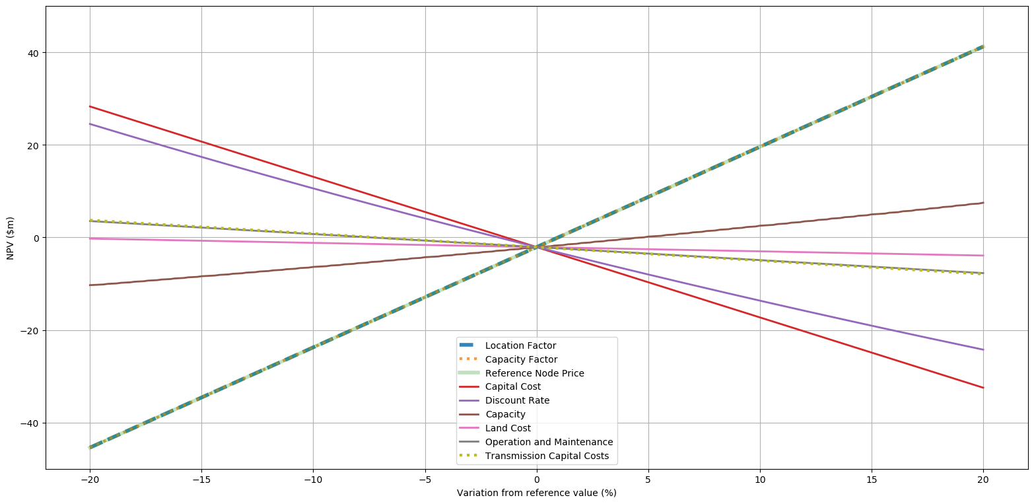
Solar NPV Sensitivities
Electricity price
Capacity Factor
Capital Cost
Cost of Capital
Capacity
O&M
Transmission
Land
-Confidential-

Slide 22
What the forecast uptake is and where
-Confidential-

Slide 23
EDGS Scenario Two Transmission
Low IRR requirement (6.5%)
Higher electricity price inflation (3%)
-Confidential-

Slide 24
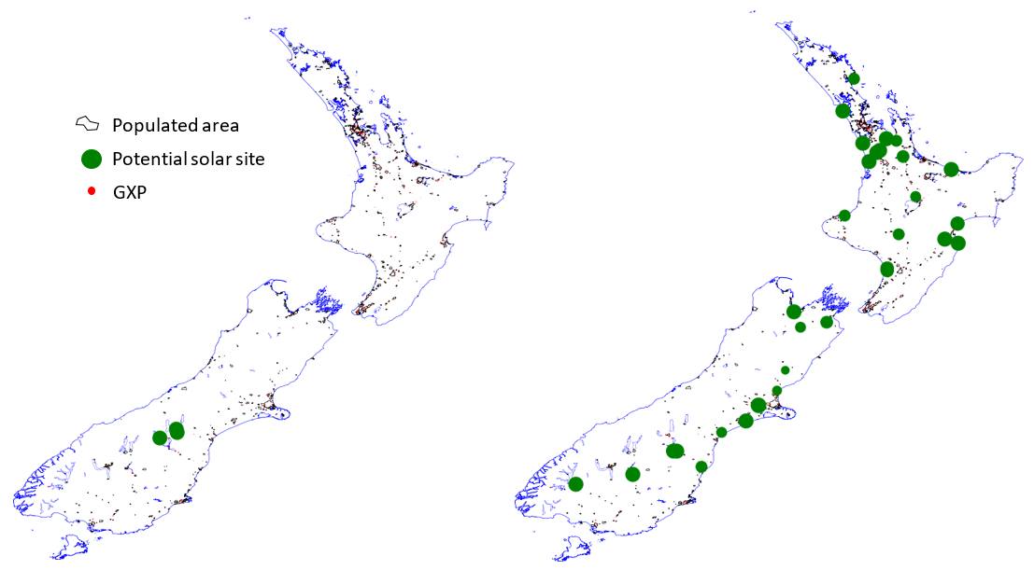
EDGS Scenario Two Transmission
Low IRR requirement (6.5%)
Higher electricity price inflation (3%)
2020-2024
580 MWp / 300 MWp
2025-2029
6,000 MWp / 2,900 MWp
-Confidential-

Slide 25
EDGS Base Scenario Transmission
Higher IRR requirement (8.5%)
Average electricity price inflation (2%)
-Confidential-

Slide 26
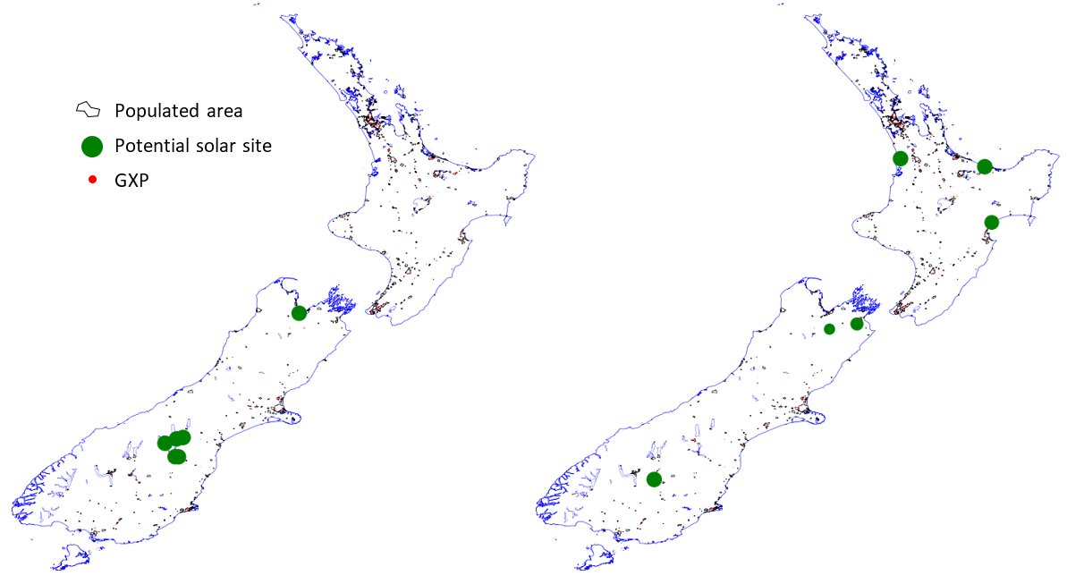
EDGS Base Scenario Transmission
Higher IRR requirement (8.5%)
Average electricity price inflation (2%)
2025-2029
1,200 MWp / 600p MW
2030-2034
2,200 MWp / 1,500 MWp
-Confidential-

Slide 27
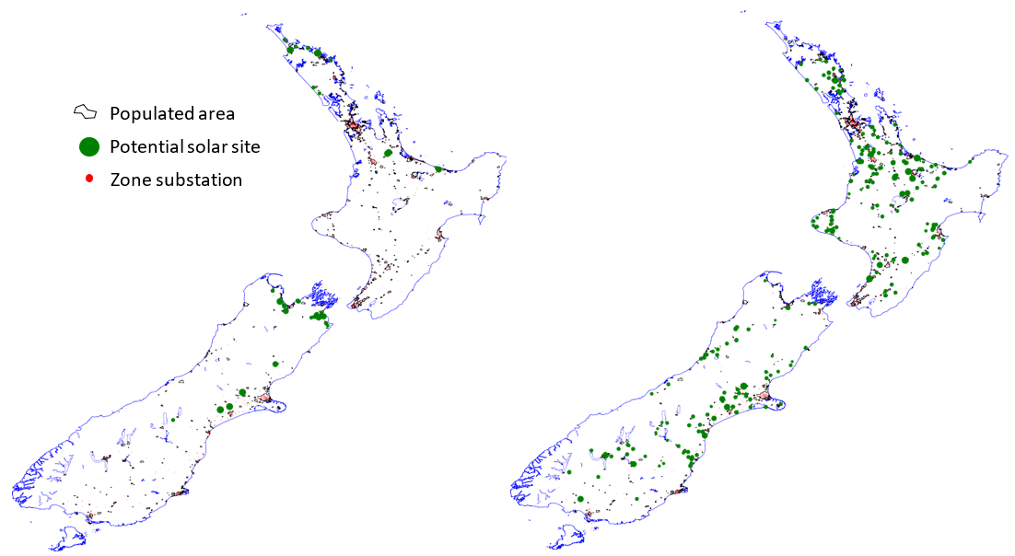
EDGS Scenario Two Distribution
Low IRR requirement (6.5%)
Higher electricity price inflation (3%)
2025-2029
330 MWp / 90 MWp
2030-2034
1,700 MWp / 1,100 MWp
-Confidential-

Slide 28
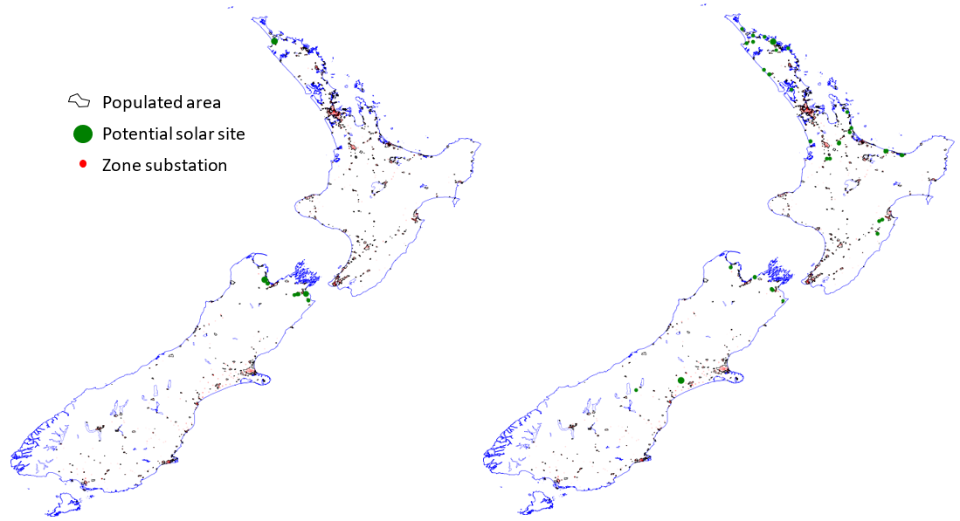
EDGS Base Scenario Distribution
Higher IRR requirement (8.5%)
Average electricity price inflation (2%)
2030-2034
80 MWp / 0 MWp
2035-2039
280 MWp / 0 MWp
-Confidential-

Slide 29
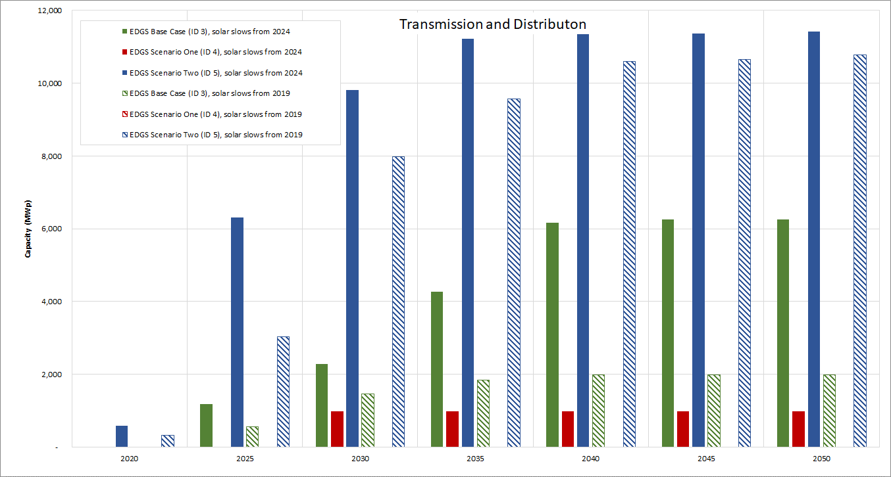
Transmission & Distribution Capacity
5,700 Ha
3,500 GWh
-Confidential-

Slide 30
Key Conclusions
There is a significant amount of suitable land for PV development in New Zealand
  Enough for many 10s of GW
However land & transmission proximity will be greater determinants than the NPV sensitivity indicates
  While land and transmission cost is ~ an order of magnitude lower than solar farm cost, it is often the case that availability of land with no other use leads to considering solar, OR most other inputs are roughly equal and therefore land and transmission cost determine the most favourable areas
Transmission connected systems appear more economic that distribution connected systems
Capacity of distribution connected solar is about 5-15% of transmission connected solar
The reader should view forecasts in conjunction with changes that may affect electricity price and location factors
High uptake may depress wholesale prices, negating the high rate of return and forecasts
Forecasts are sensitive to world-wide solar production
Lowering cost of capital may give rise to more projects. Need to balance this with potentially lower electricity price inflation
Once economic and under development, solar capacity could increase rapidly over a period of 10-15 years
-Confidential-

Slide 31
Questions

Slide 32
Utility-Scale Solar Technology
-Confidential-

Slide 33
Utility-Scale Solar Technology and Grid Connection
Crystalline silicon considered
Capacity factor combined with capital cost is crucial
Capacity factor maximised using
  single-axis tracking (azimuth or east-west tracking)
    Increases energy yield throughout the day
    Most systems in the US are now single-axis tracking
  array over-capacity (inverter loading ratio)
    Increases energy yield, offsets module degradation but can result in ‘capping’ and cost
-Confidential-

Slide 34
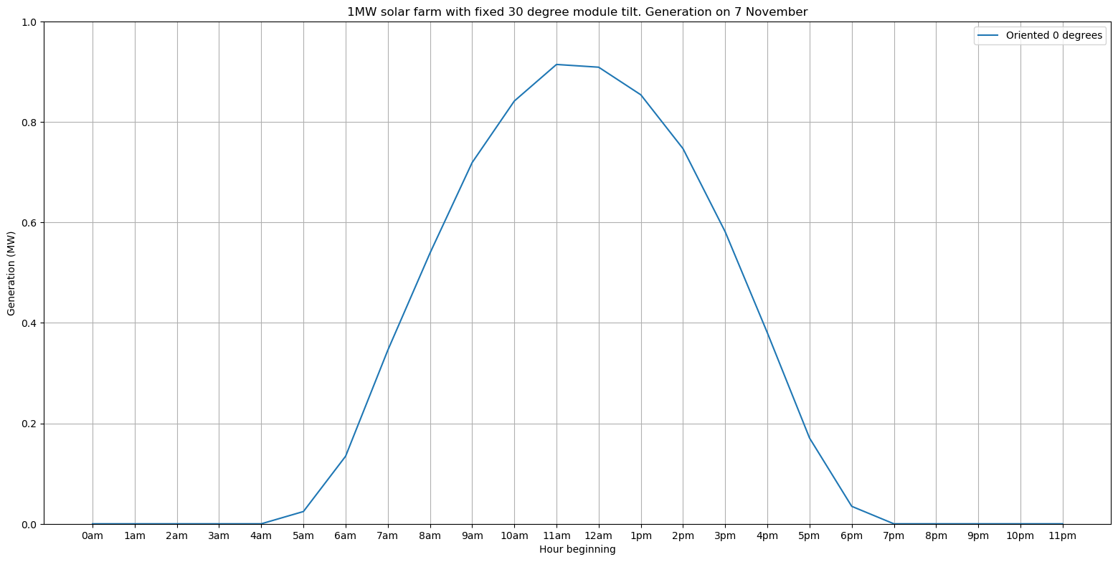
Generation on 7 November
(NZST)

Slide 35
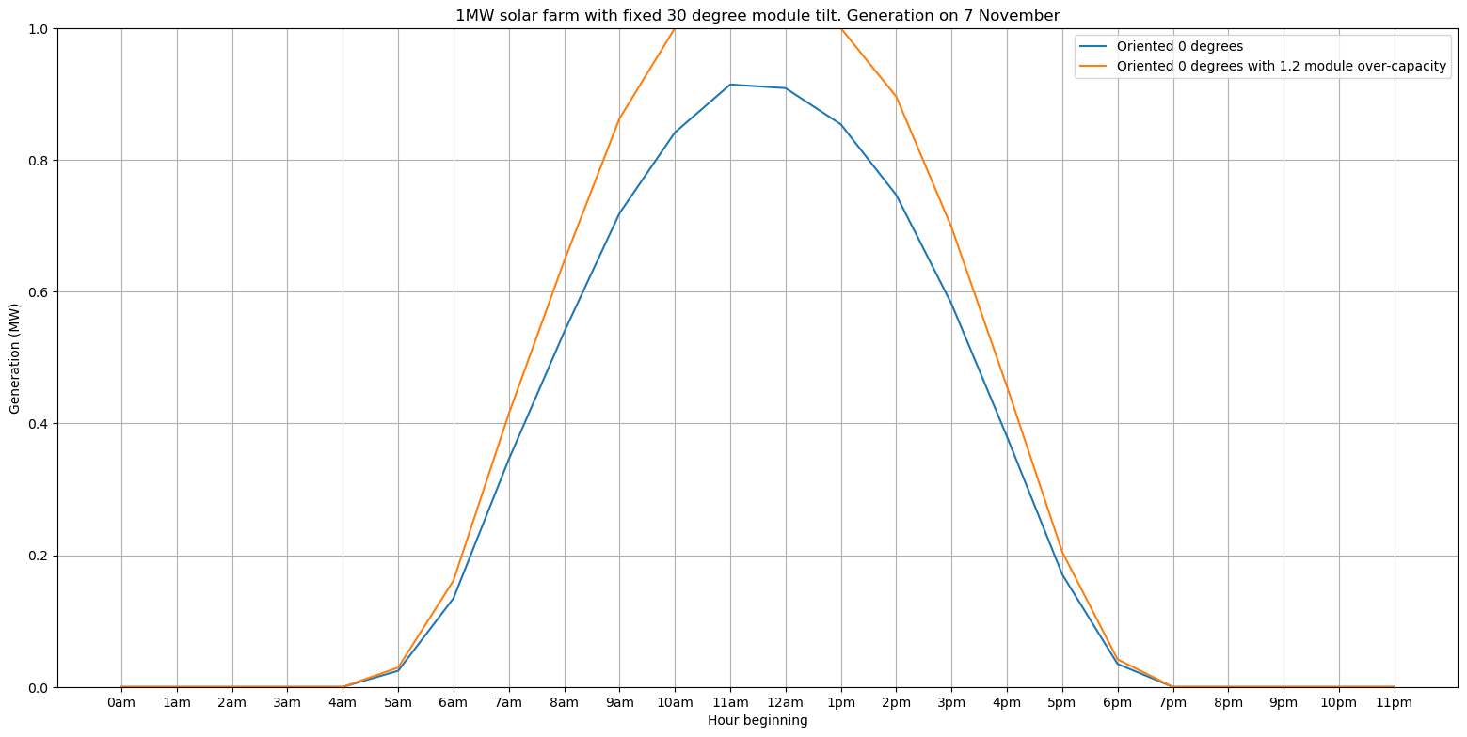
Module over capacity
(NZST)

Slide 36
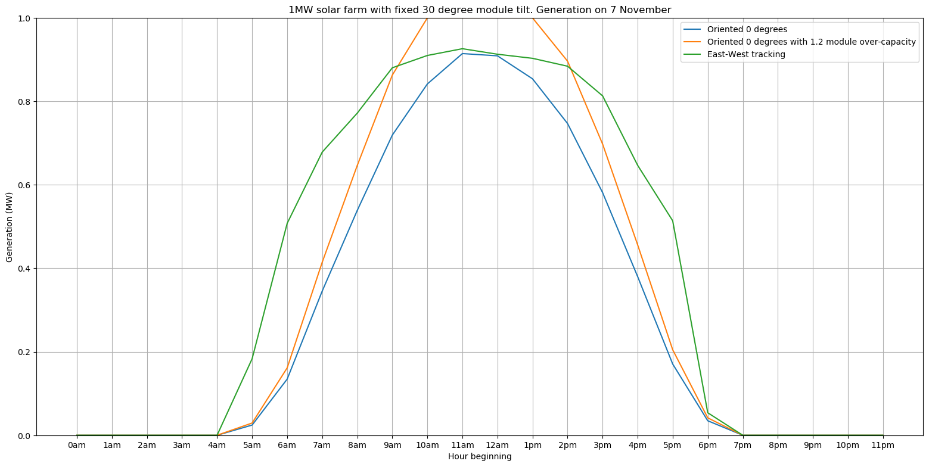
Single axis tracking from east to west
(NZST)

Slide 37
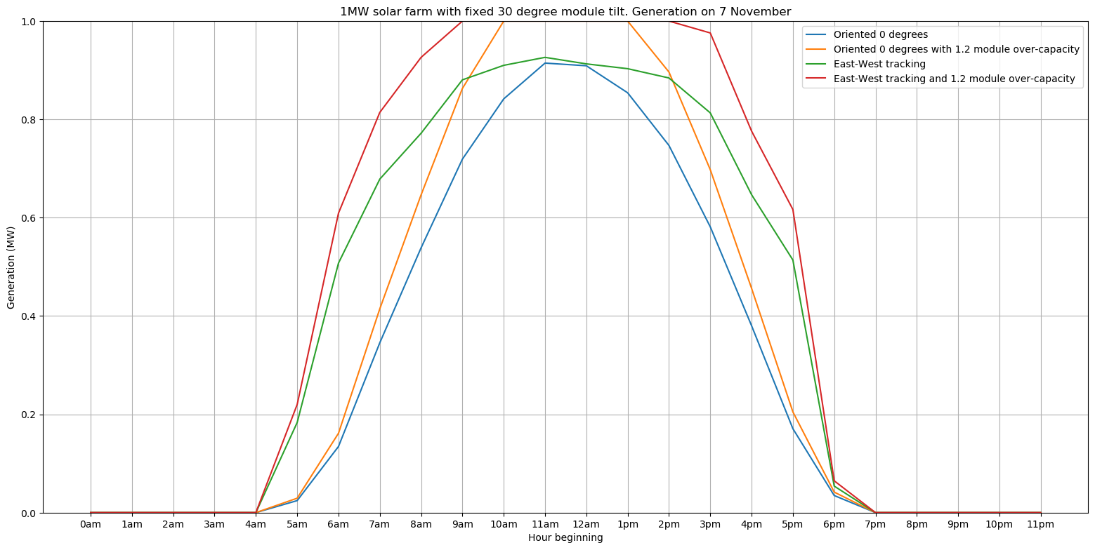
Single axis tracking and module over capacity
(NZST)

Slide 38
Summary:
Configuration | Capacity factor range |  | Pros / cons
Fixed modules, no module over capacity | 0.158 | 0.164 | Lower cost but less energy
Module over capacity of 1.2 x | 0.191 | 0.198 | More energy but higher cost
Single axis tracking from east to west | 0.188 | 0.195 | More energy but higher cost
Single axis tracking and module over capacity | 0.224 | 0.233 | Even more energy but even higher cost
-Confidential-

Slide 39
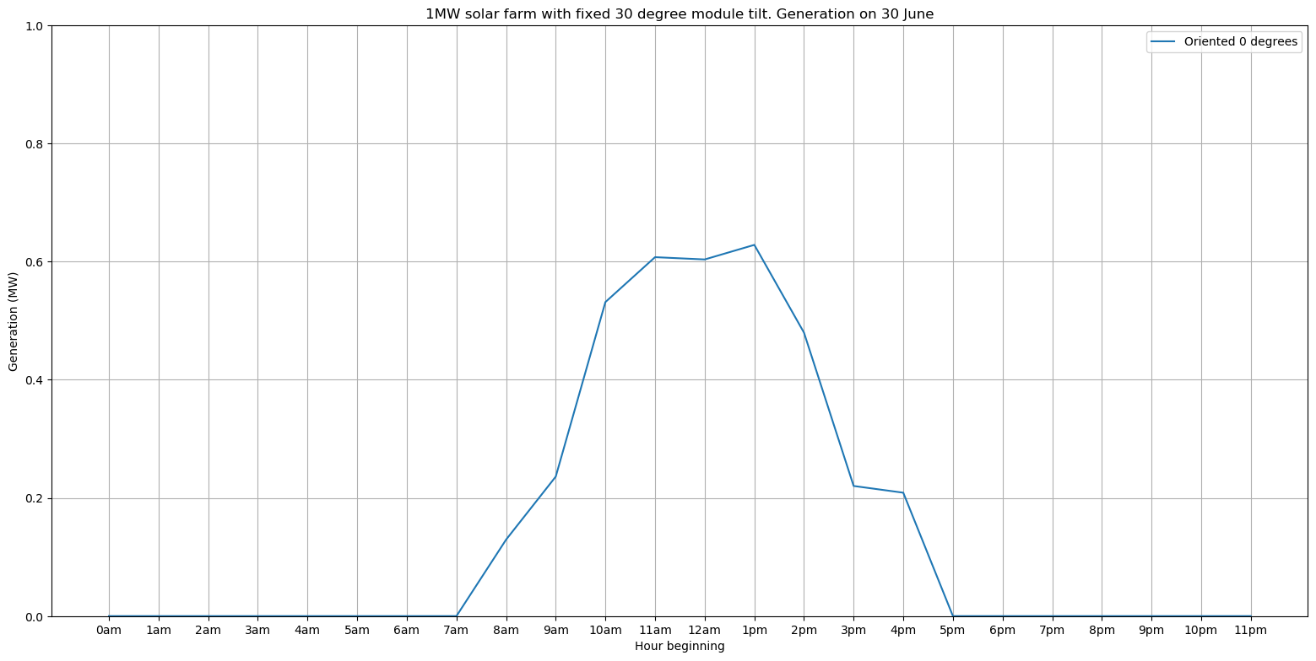
Generation on 30 June and contribution to peak demand…
(NZST)

Slide 40
Why is distribution capacity less than transmission?
Connecting to 11 kV only 1-2 solar farms of ~2 MW can be supported
Similarly with connection to a zone substation
By contrast transmission connected can connect many 100s of MW across many GXPs, and has better economy of scale
-Confidential-

