Slide 1

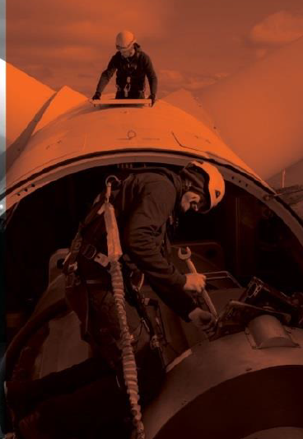
Shared Learning
Critical Risk:
Learning Event Title
Location
Insert Picture here
What happened?
What did we learn?

